Slide 1
2Market – Exploratory Analysis & Insights by Rohan Vijay Kumar
Notes:
Hello, I’m Rohan Vijay Kumar, and this is my analysis of customer and marketing performance for 2Market, a global supermarket brand.
The business objective was to help 2Market better understand who their customers are, how they shop, and which marketing strategies are driving real results.

Slide 2
Customer Demographics

Slide 3
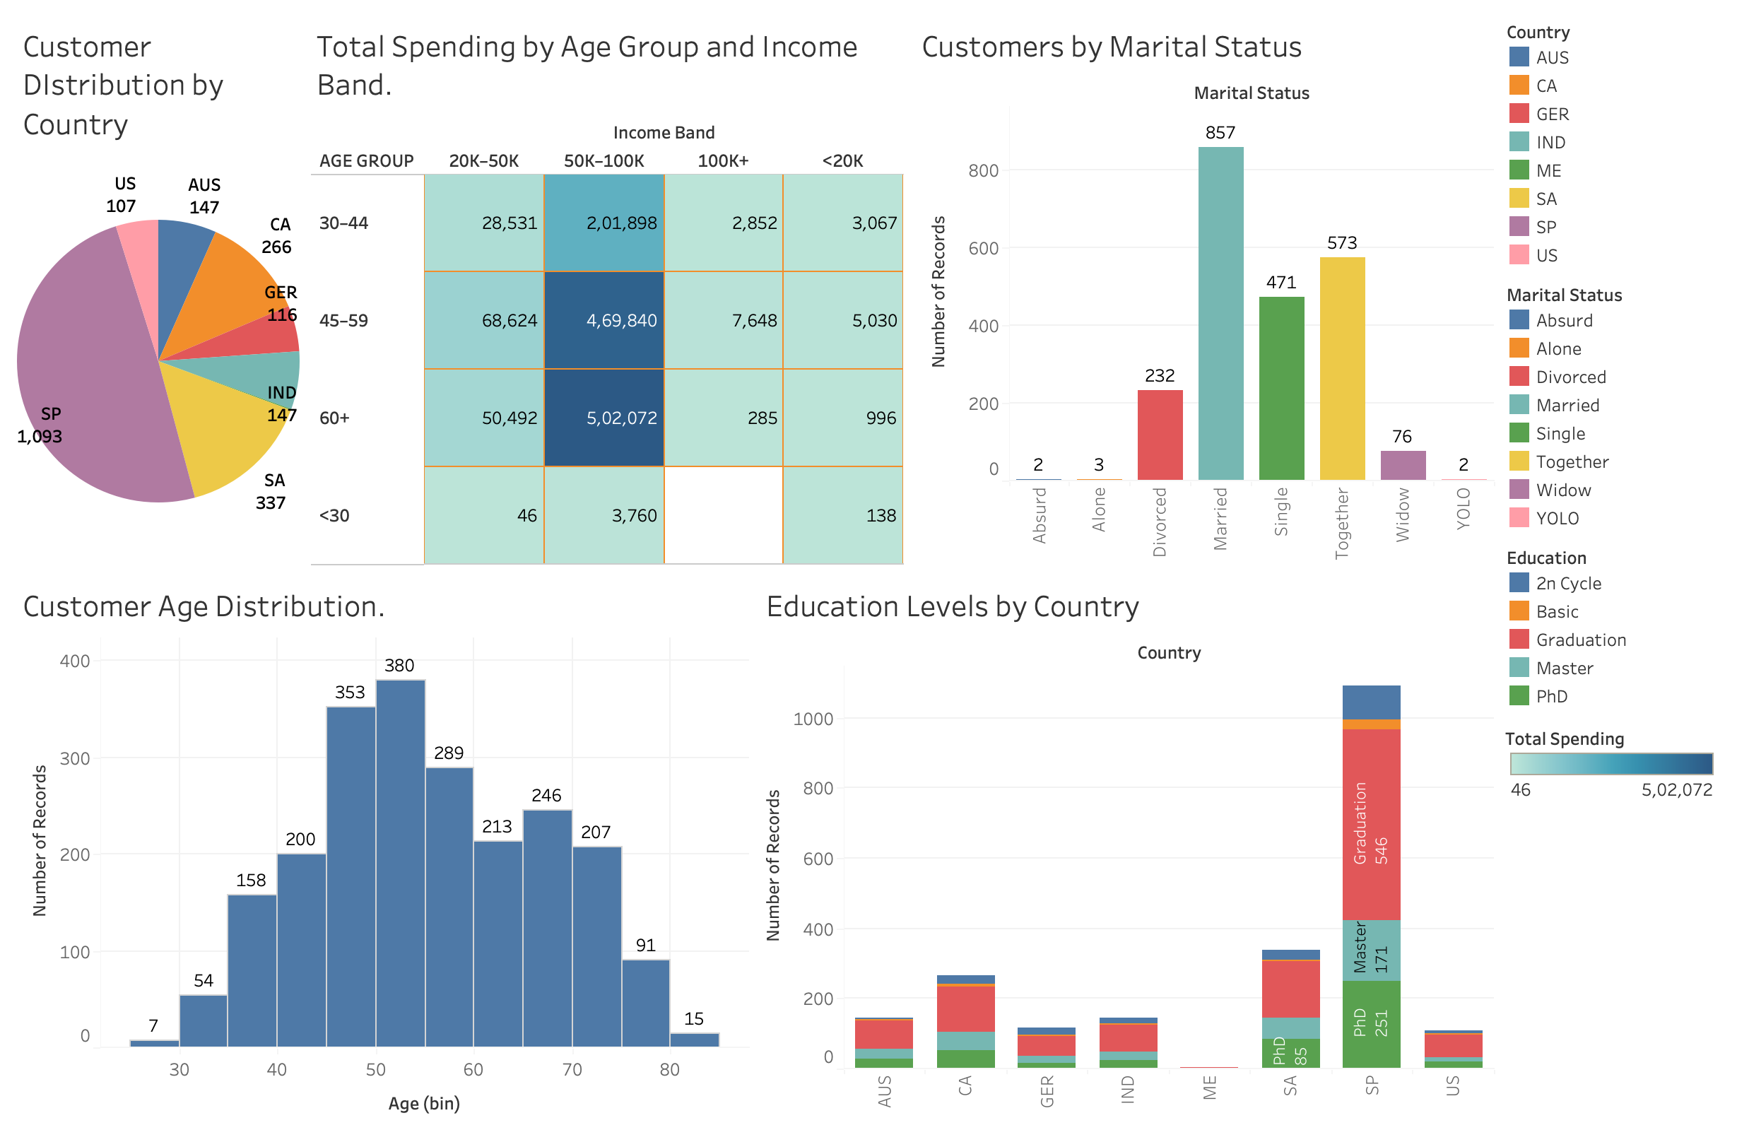
Notes:
The first chart is a pie chart showing customer distribution by country. We can see that Spain, South Africa and Canada have the largest customer bases, indicating strong brand presence and campaign performance in these markets. I've also included a stacked bar chart by education level and country, which reveals that higher-educated segments are more concentrated in Canada and Spain. What stands out is that customers aged 45–60 with incomes above 50K are the highest spenders. This segment is ideal for targeted loyalty or premium product campaigns.

Slide 4
Ad Channel Effectiveness

Slide 5
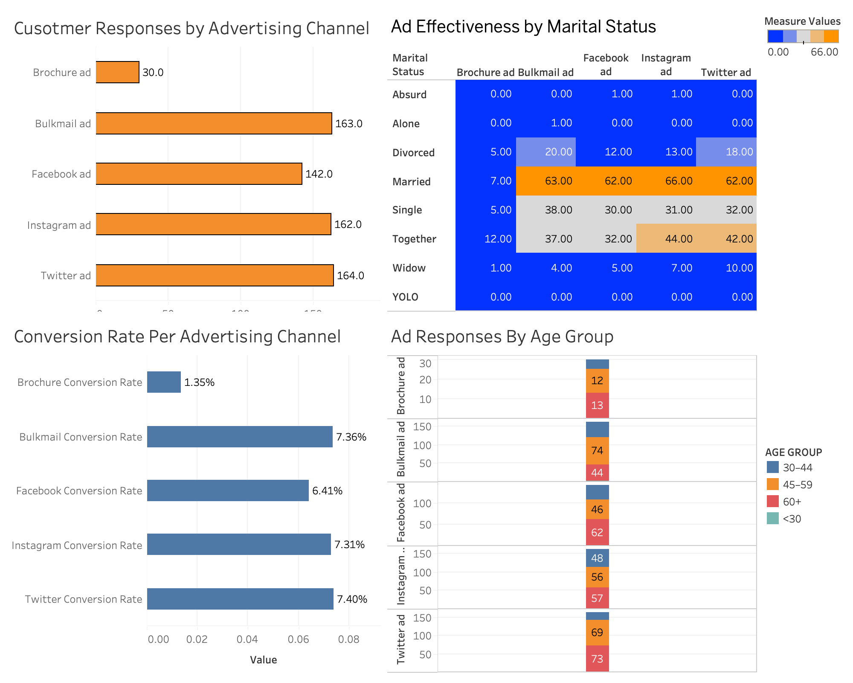
Notes:
At the bottom left, we have conversion rates for each platform — calculated by dividing responses by total impressions. Instagram and Twitter had similar conversion rates, all above 7%. In contrast, brochures converted at just 1.3%.
This highlights a key opportunity: 2Market should reduce investment in underperforming offline ads and reinvest in high-performing digital channels.
The final visual is a stacked bar chart showing how ad responses vary by age group. Instagram was most effective among younger customers under 45, while Facebook had broad appeal. Twitter saw relatively even engagement, making it a good general-purpose channel.”

Slide 6
Product Spend & Campaign Response

Slide 7
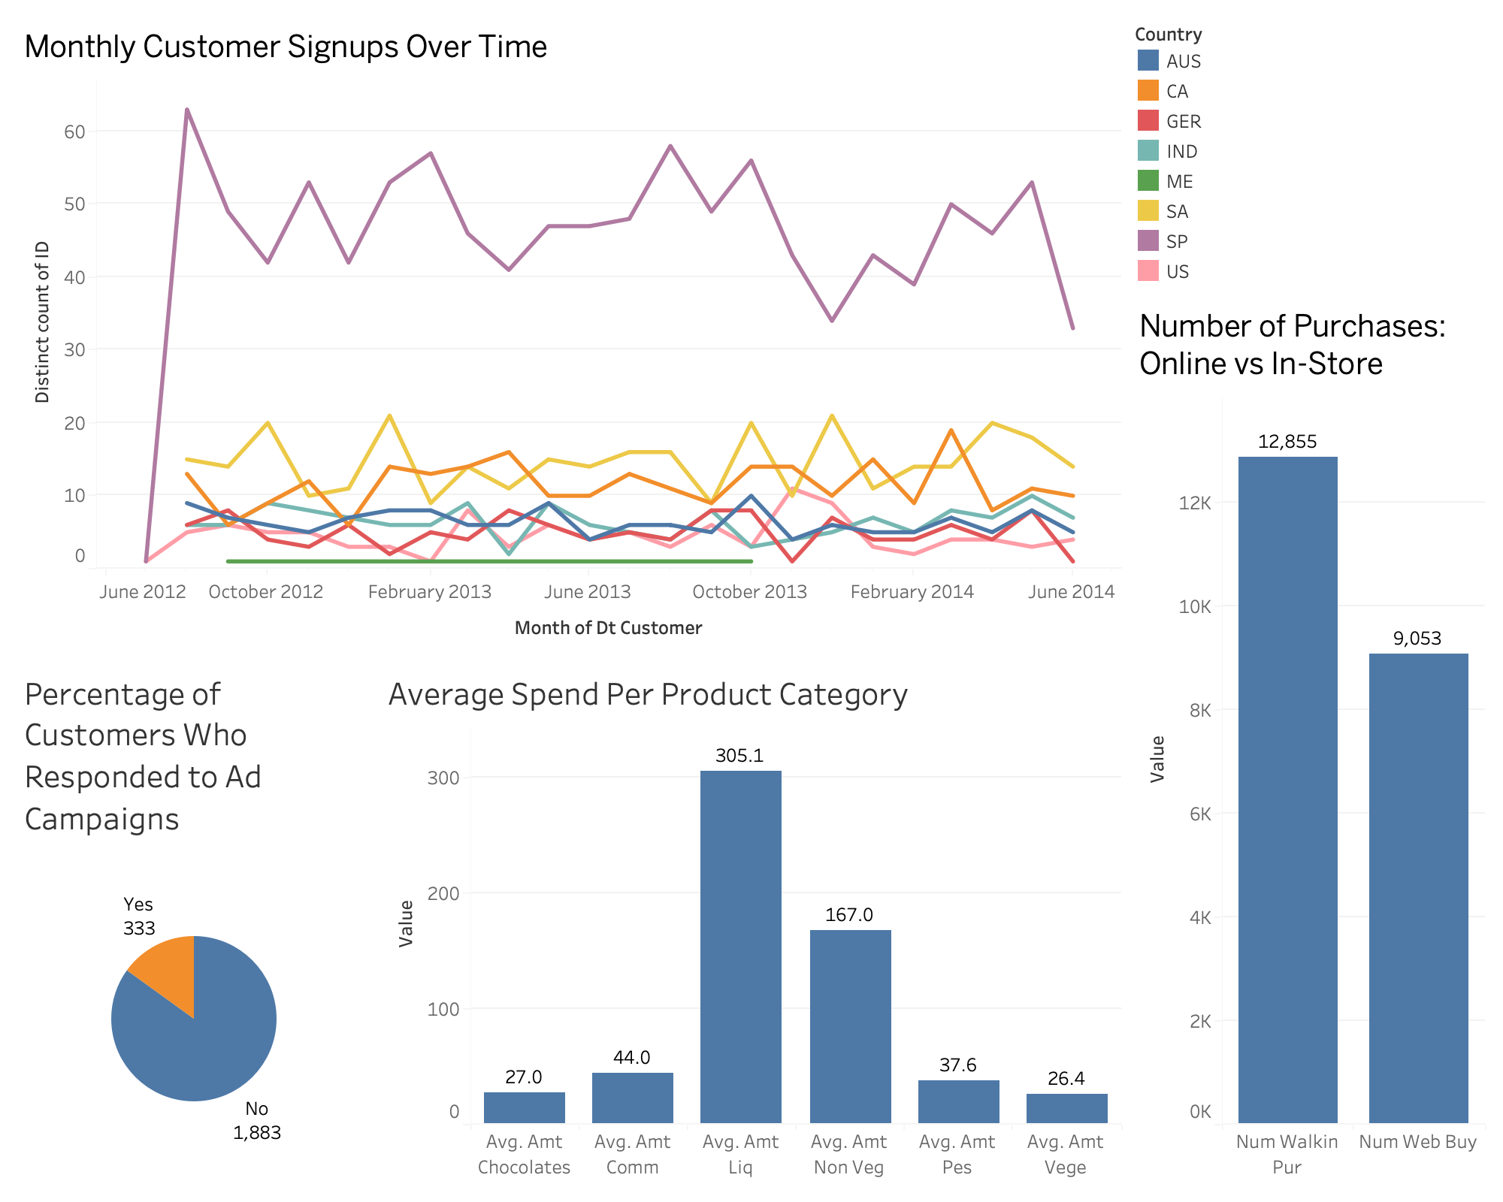

Slide 8
Conclusions and Remarks
First, 2Market should double down on digital advertising, particularly Instagram, Twitter and Facebook, where both engagement and conversion are strongest.
Second, there’s a clear high-value customer segment: married or cohabiting individuals aged 45–60 with income between 50K – 100K. They spend the most and are most loyal, perfect for tailored loyalty programs.
And third, campaign engagement is low across the board. 2Market can improve this by refining segmentation, and phasing out channels like brochures ads.

